Slide 1

Week04 - Tables & Lists (UITableView)
In the AI Era(Swift + SwiftUI)
Instructor : Mr. Nem Sothea
nemsothea13@gmail.com

Slide 2
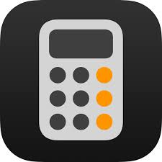
2. What We'll Learn
📚 Learning Objectives
• Understand UITableView components
• Master UITableViewDataSource protocol
• Implement UITableViewDelegate methods
• Build a functional todo list app
• Handle user interactions
• Manage app state

Slide 3
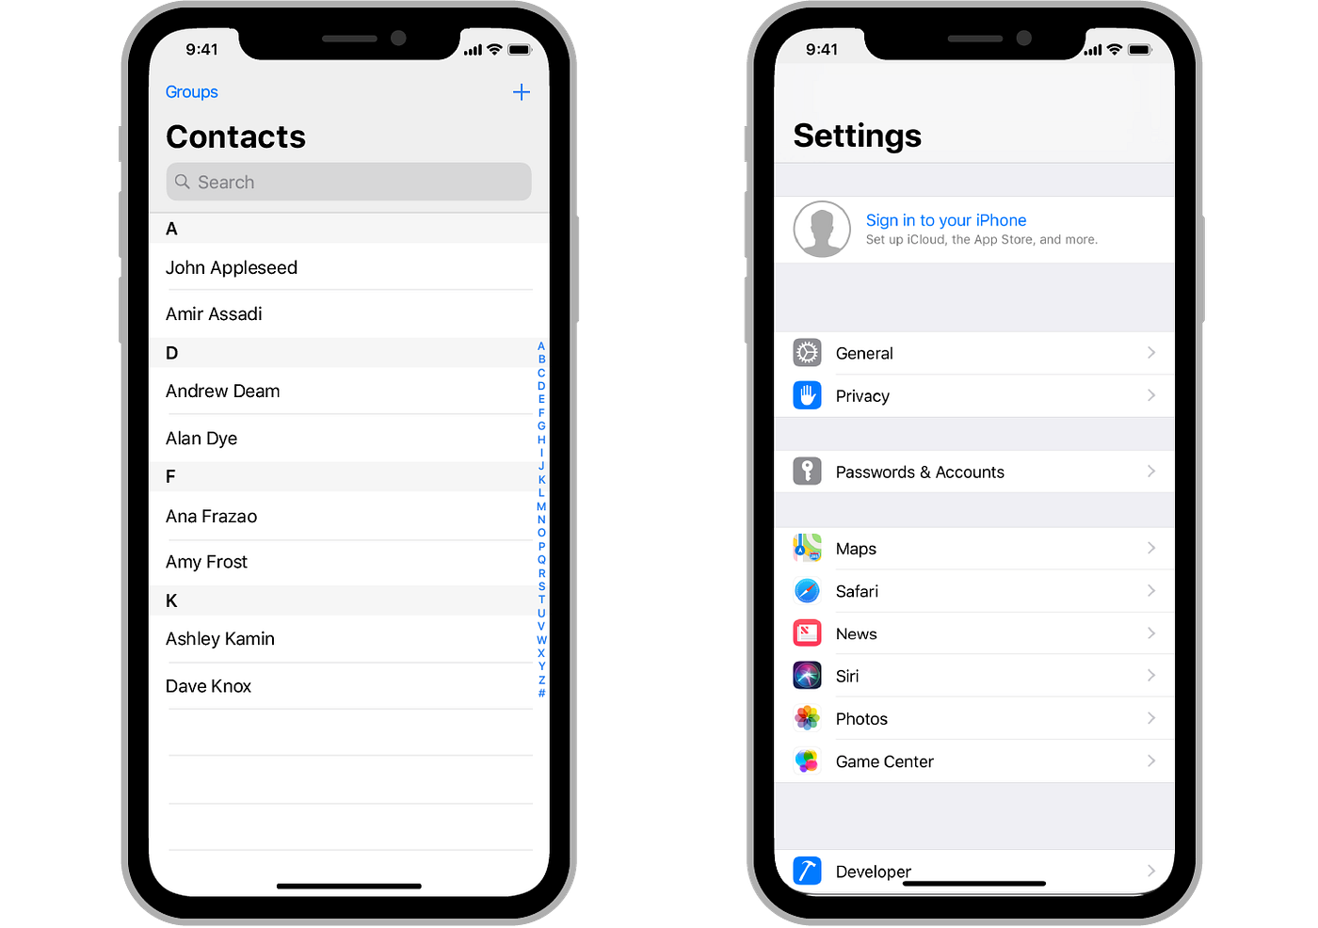
3. 📱 UITableView
• Most fundamental iOS component
• Displays scrollable lists of data
• Used in: Settings, Contacts, Messages, etc.
• Highly optimized for performance
• Supports millions of rows through cell reuse

Slide 4
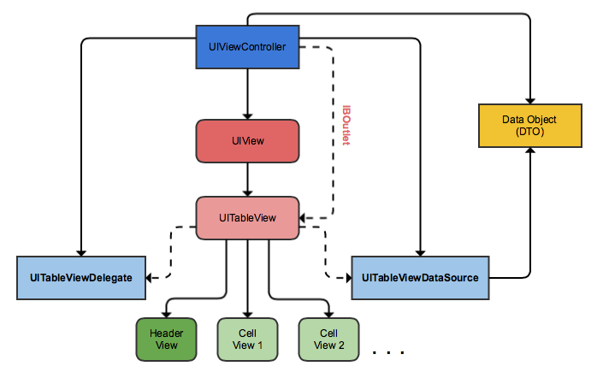
4. UITableView Core Components
⚙️ Key Components
• Sections - Groups of related rows
• Rows - Individual items in sections
• Cells - Visual representation of rows
• DataSource - Provides data to display
• Delegate - Handles user interactions

Slide 5
5. UITableViewDataSource Protocol
📊 Providing Data
Required Methods:
1. numberOfSections(in:)
- How many sections in the table?
2. tableView(_:numberOfRowsInSection:)
- How many rows in each section?
3. tableView(_:cellForRowAt:)
- How to configure each cell?

Slide 6
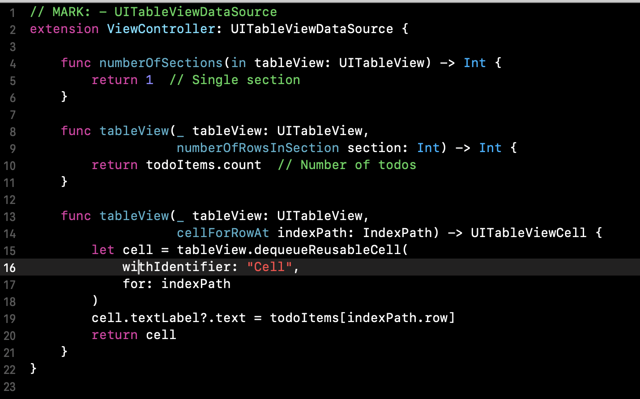
6. DataSource Code Example

Slide 7
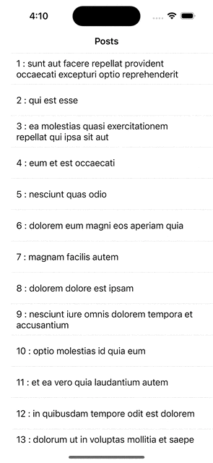
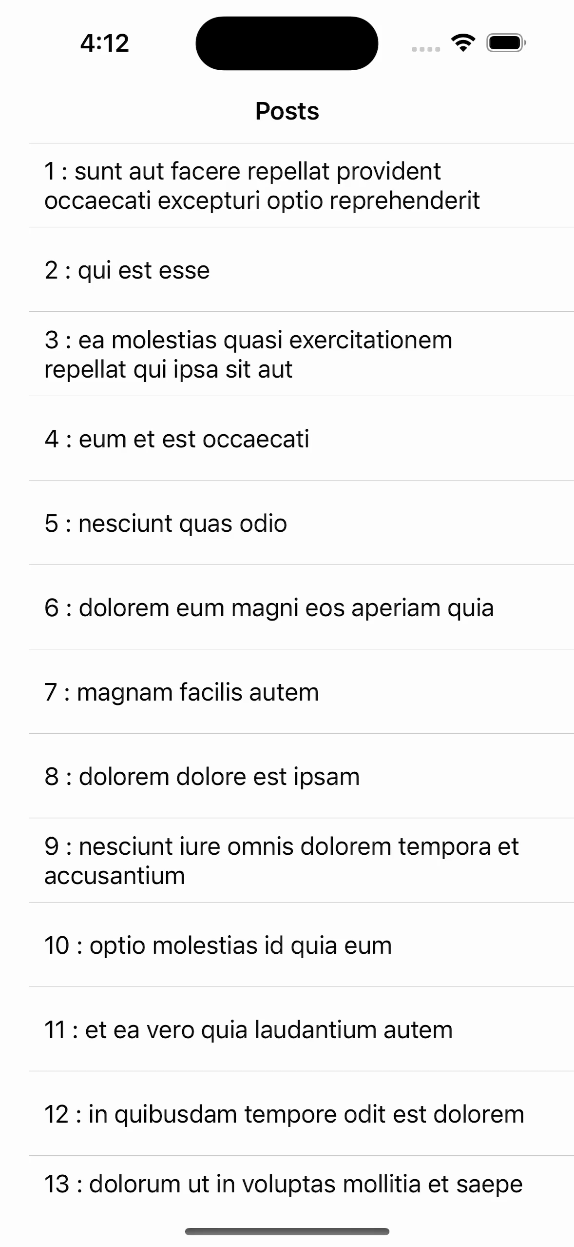
7. Cell Reuse Concept
🔄 Cell Reuse - Performance Magic
• Why? Memory efficiency with large lists
• How? Recycles cells that scroll off-screen
• Only create enough cells to fill screen
• Reconfigure for new data as needed

Slide 8
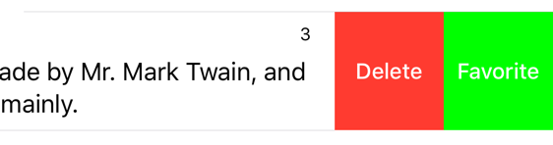
8. UITableViewDelegate Protocol
👆 Handling Interactions
Common Delegate Methods:
• didSelectRowAt - User taps a row
• commit editingStyle - Swipe to delete
• heightForRowAt - Custom row heights
• willDisplay - Cell about to appear

Slide 9
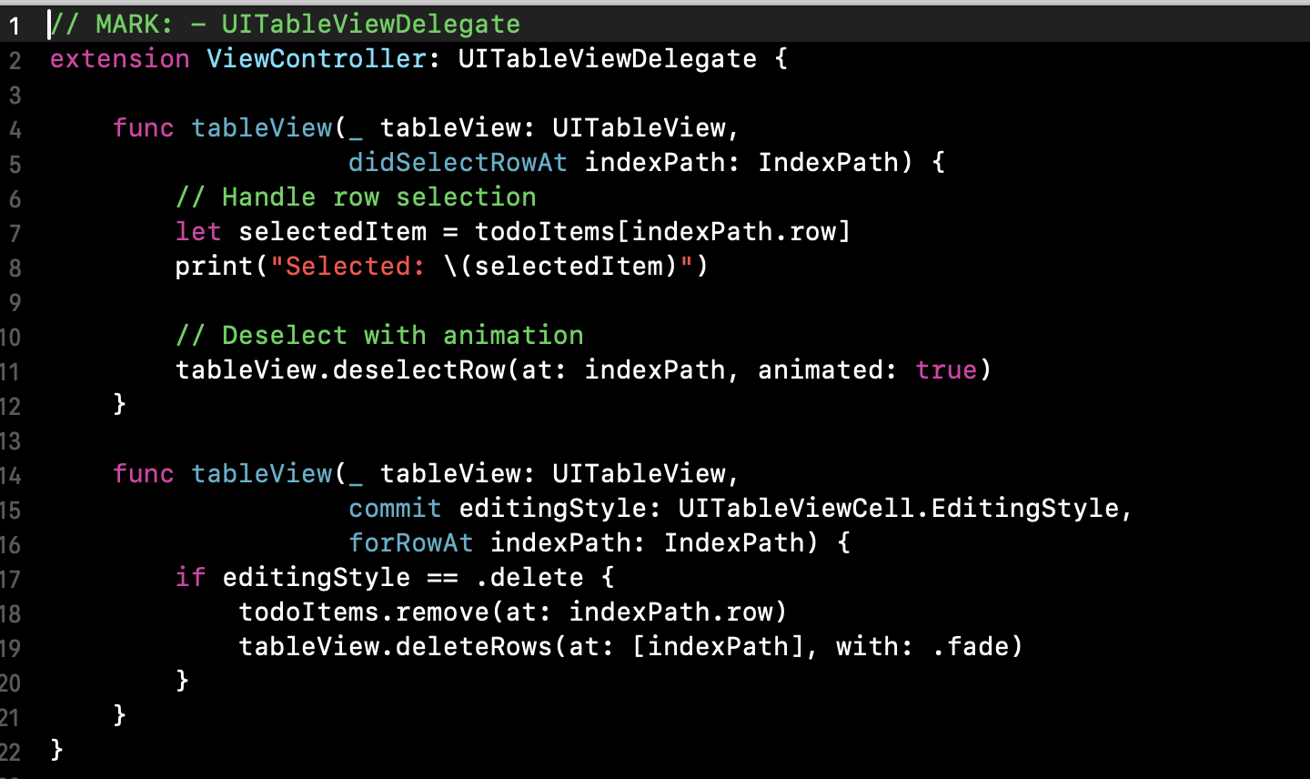
9. Delegate Code Example

Slide 10
10. Project Setup Demo

Slide 11
Common problem
⚠️ Watch Out!
• Forgetting to set dataSource/delegate
• Not calling reloadData() after data changes
• Using wrong indexPath in cellForRowAt
• Not handling cell reuse properly
• Forgetting to deselect rows in didSelectRowAt
💡 Pro Tip: Always use dequeueReusableCell!

Slide 12
Best Practices
🏆 UITableView Excellence
• Use meaningful cell identifiers
• Implement efficient cell configuration
• Handle empty states gracefully
• Use proper animations
• Test with large datasets
• Follow Apple's Human Interface Guidelines

Slide 13
Hands-On Exercise
Enhance the todo app:
1. Add completion toggle (checkmarks)
2. Implement swipe to complete
3. Add sections for "Active" and "Completed"
4. Create a custom cell with better UI
5. Add persistence with UserDefaults
Time: 30 minutes

Slide 14
Homework
🚀 Beyond Basics
• UICollectionView - Grid layouts
• Core Data or SwiftData - Robust data persistence
• Custom Cell Design - XIB files, programmatic UI
• Diffable Data Source - Modern data handling
• Compositional Layout - Advanced collection views
Resources: Apple Documentation, WWDC Videos
* Please send me github link by email

Slide 15
Summary
📝 Key Takeaways
• UITableView = Data + Interactions
• DataSource provides content
• Delegate handles user actions
• Cell reuse enables performance
• Always update data model before UI
🎉 You can now build most list-based iOS apps!

Slide 16
Questions?
Next Week: Data in UIKit ~
Thank you!

